Slide 1

Personal development plan overview
Pet project by Ihor Kovalenko

Slide 2
Project Overview
The Book Review System is a platform for users to search for books and add reviews. Registered users can submit and rate book reviews. The system displays book ratings and review counts, providing insights into book quality in addition to the reviews themselves. Technologies used include NestJS, PostgreSQL, Elasticsearch, Kafka, and GCP to ensure robust functionality and scalability.

Slide 3
Structure
Project setup
Database Setup with PostgreSQL
Deployment and Maintenance of Distribution System
Book Service with Elasticsearch and PostgreSQL-based Cache
Review Service with Kafka and Distributed Transactions
User Service with GCP Identity Platform
Unit Testing

Slide 4
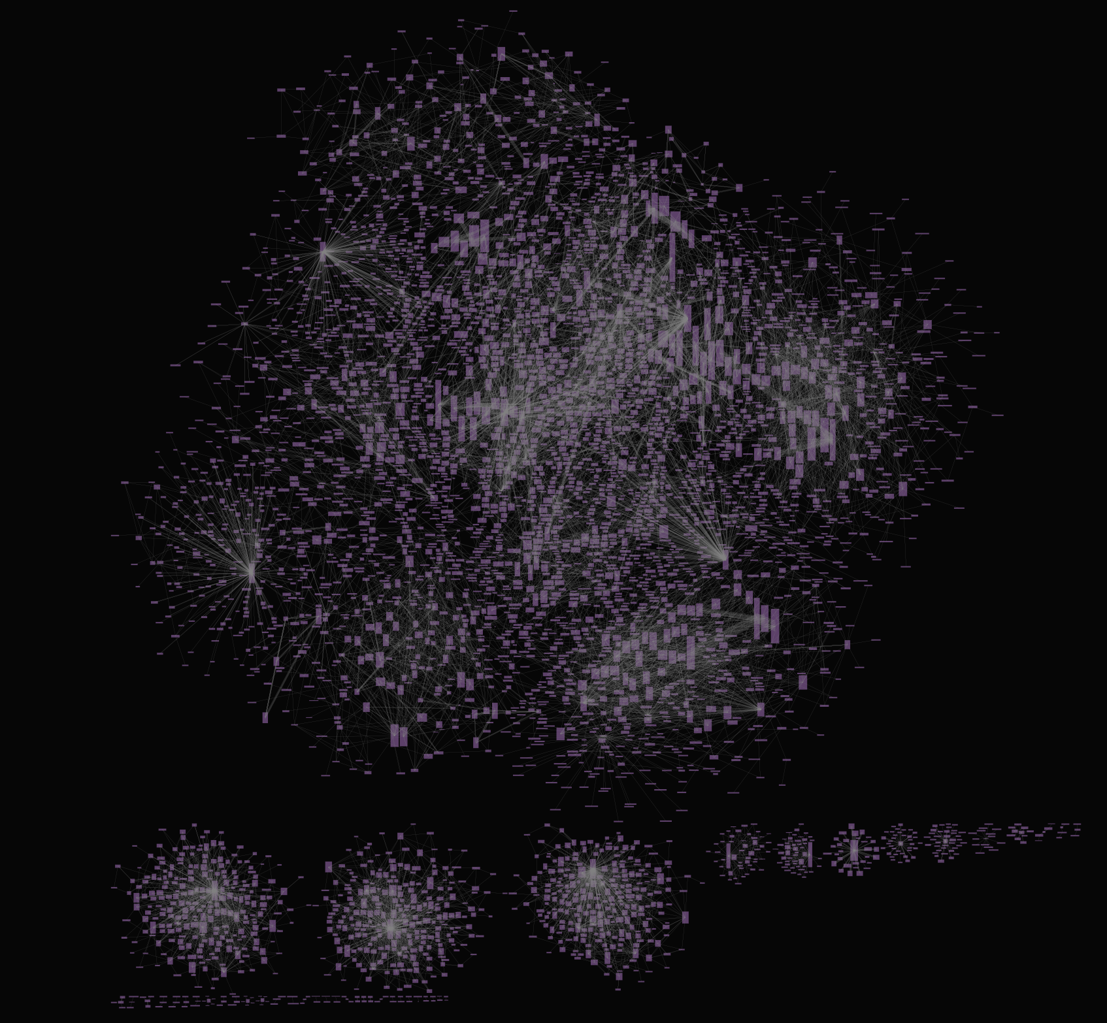
Overall structure

Slide 5
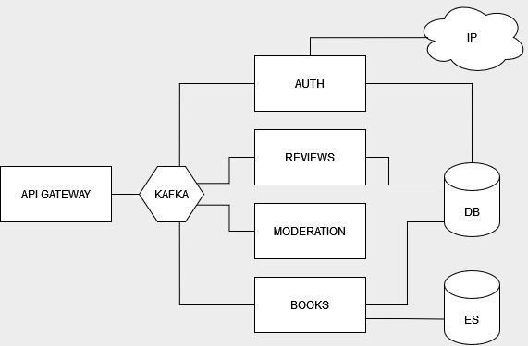
Overall structure

Slide 6
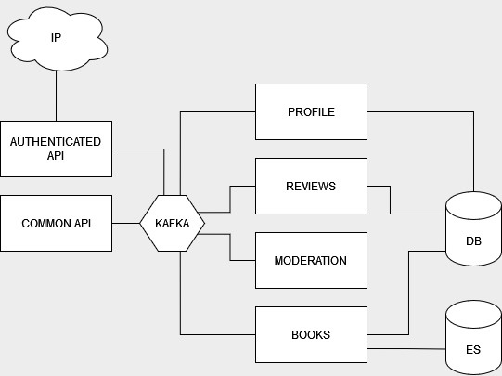
Overall structure

Slide 7
1. Project setup
Initialize three NestJS projects: UserService, BookService, and ReviewService
Set up a Git repository for version control
Prepare basic folder structures and configurations

Slide 8
Overall folder structure

Slide 9
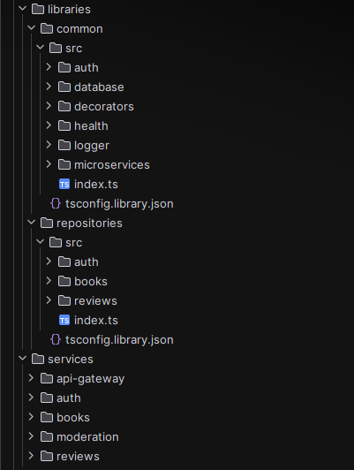
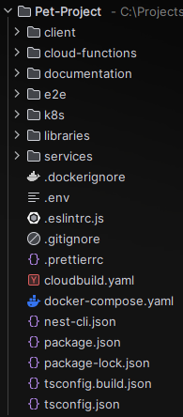
Folder structure
Common – reusable code and modules across services
Repositories – reusable DAL layer
Services – actual services code

Slide 10
Nest code organization mode comparison
Standard
Monorepo
individual project-focused applications
don't need to optimize for sharing modules
don't or optimizing complex builds
treats code artifacts as part of a monorepo
appropriate for teams of developers and/or multi-project environments
automates parts of the build process to make it easy to create and compose modular components
promotes code re-use
makes integration testing easier
makes it easy to share project-wide artifacts like eslint and other configs
easier to use than alternatives like github submodules

Slide 11
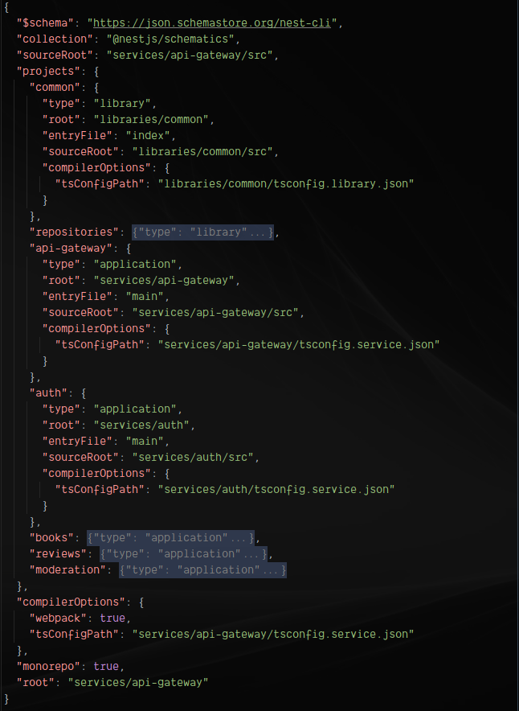
Defining monorepo in nest-cli.json
Coordinating the relationship between the components of the monorepo:
Defining each library as library
Defining each service as service
Enabling monorepo option
All workspaces have a default project: choosing api-gateway as root

Slide 12
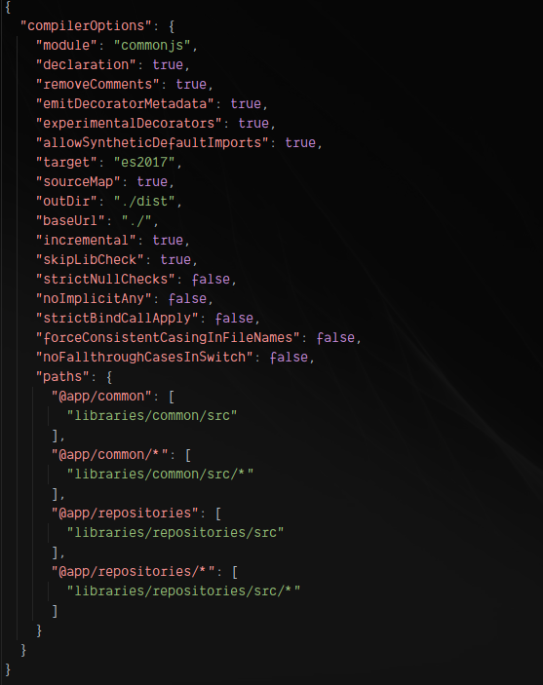
Base tsconfig.json

Slide 13
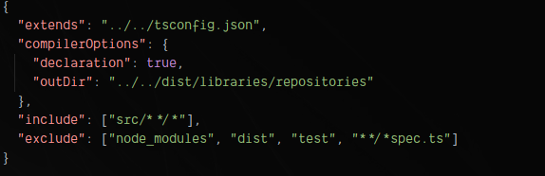
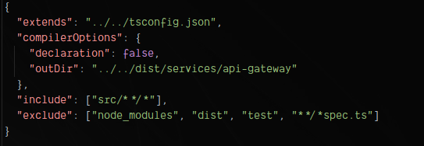
Library and service tsconfig.son

Slide 14
Microservices configuration

Slide 15
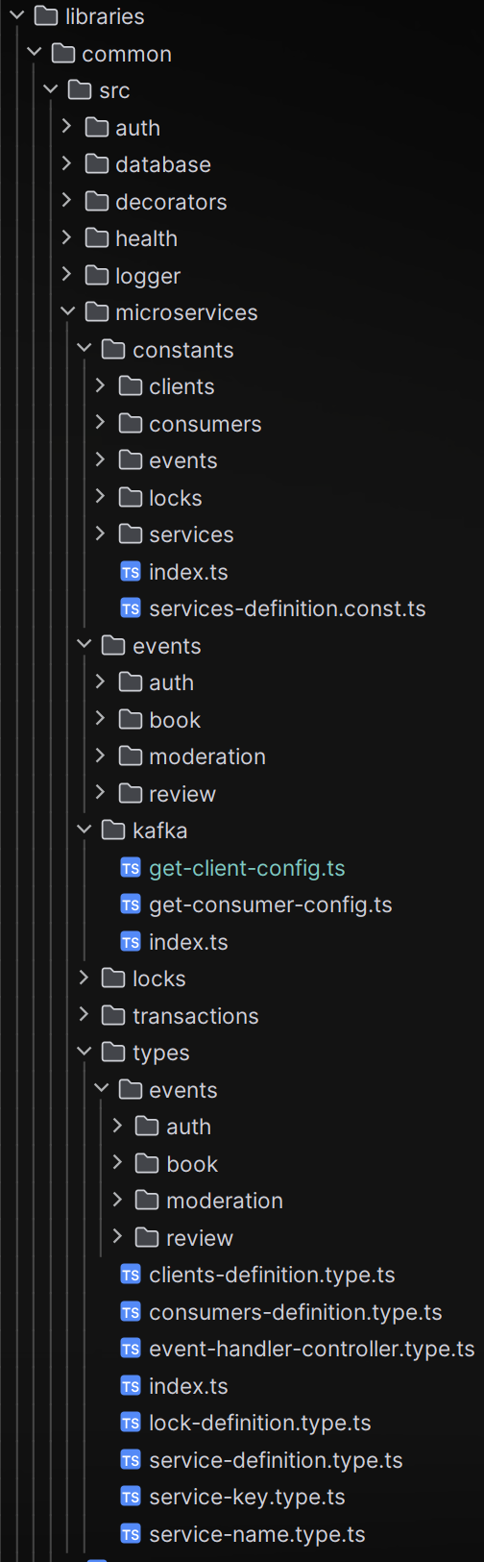
Microservices configuration folder structure
Constants to define static services, clients and consumers keys
Events define message and event schemas for each service
Types provide some abstractions and ensure type safety between keys (treat as symbols)

Slide 16
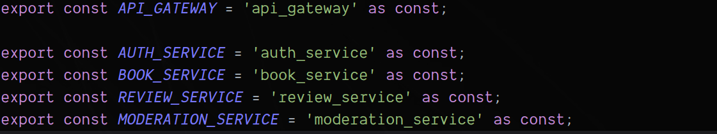
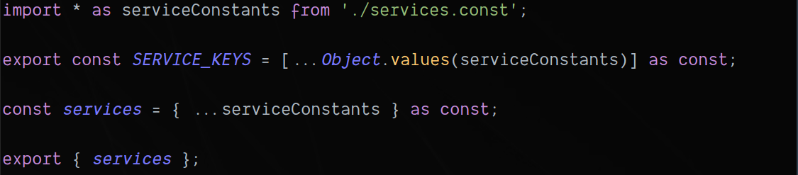
Microservices configuration Constants
services.const.ts
service-keys.const.ts
clients-definition.const(type).ts
consumers-definition.const(type).ts
services-definition.const(type).ts
get-client-config.ts
get-consumer-config.ts

Slide 17
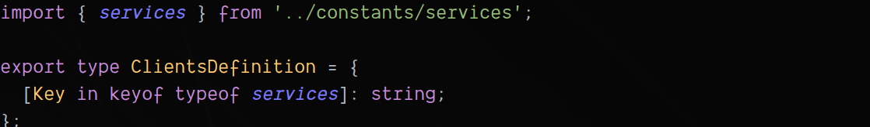
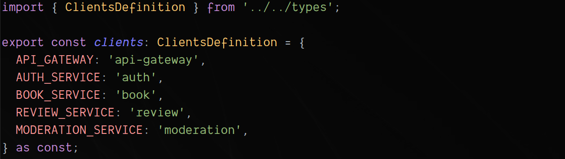
Microservices configuration Constants
services.const.ts
service-keys.const.ts
clients-definition.const(type).ts
consumers-definition.const(type).ts
services-definition.const(type).ts
get-client-config.ts
get-consumer-config.ts

Slide 18
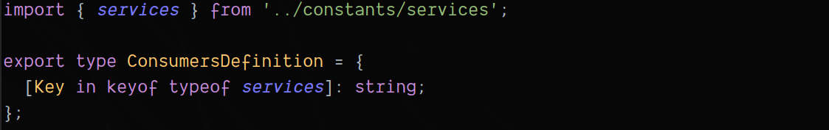
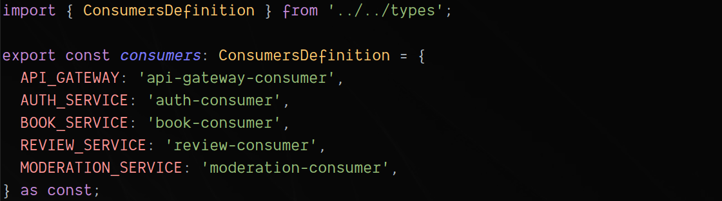
Microservices configuration Constants
services.const.ts
service-keys.const.ts
clients-definition.const(type).ts
consumers-definition.const(type).ts
services-definition.const(type).ts
get-client-config.ts
get-consumer-config.ts

Slide 19
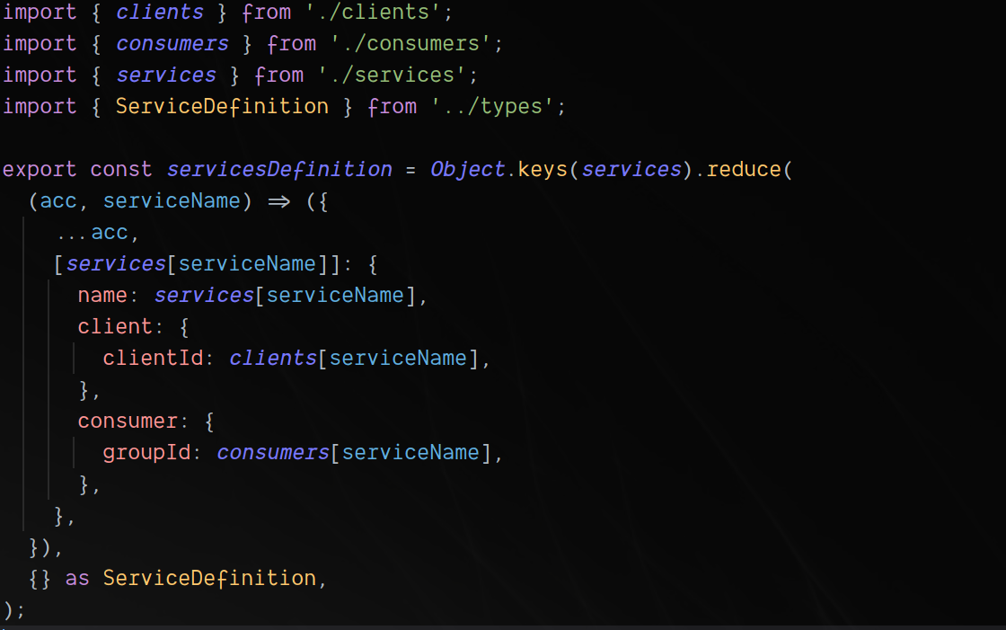
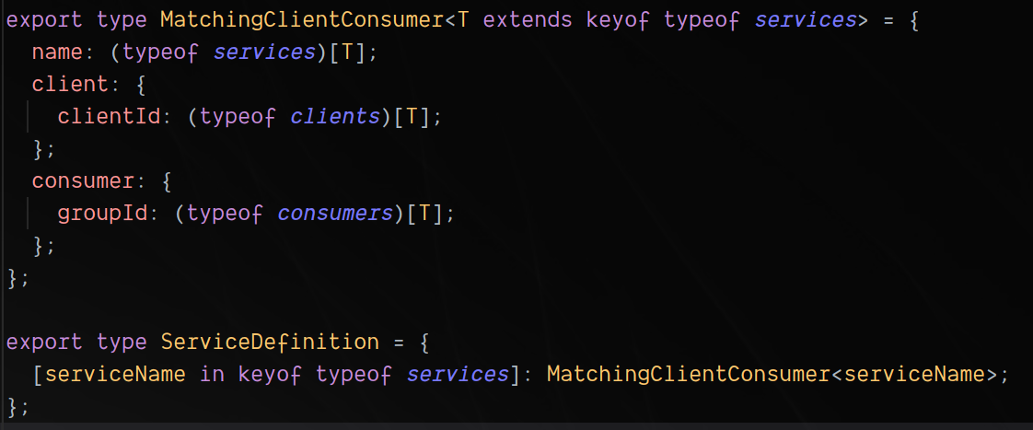
Microservices configuration Constants
services.const.ts
service-keys.const.ts
clients-definition.const(type).ts
consumers-definition.const(type).ts
services-definition.const(type).ts
get-client-config.ts
get-consumer-config.ts

Slide 20
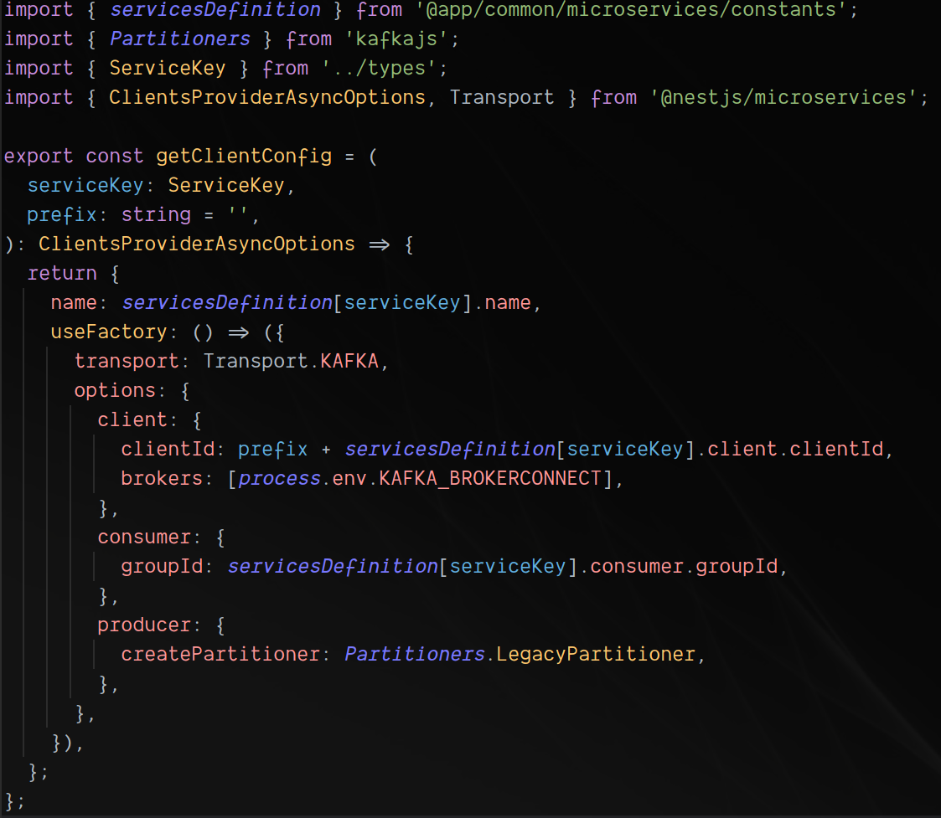
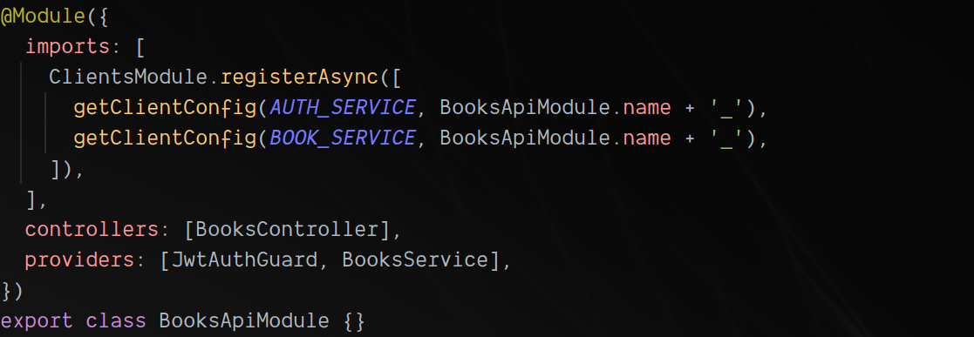
Microservices configuration Kafka
services.const.ts
service-keys.const.ts
clients-definition.const(type).ts
consumers-definition.const(type).ts
services-definition.const(type).ts
get-client-config.ts
get-consumer-config.ts

Slide 21
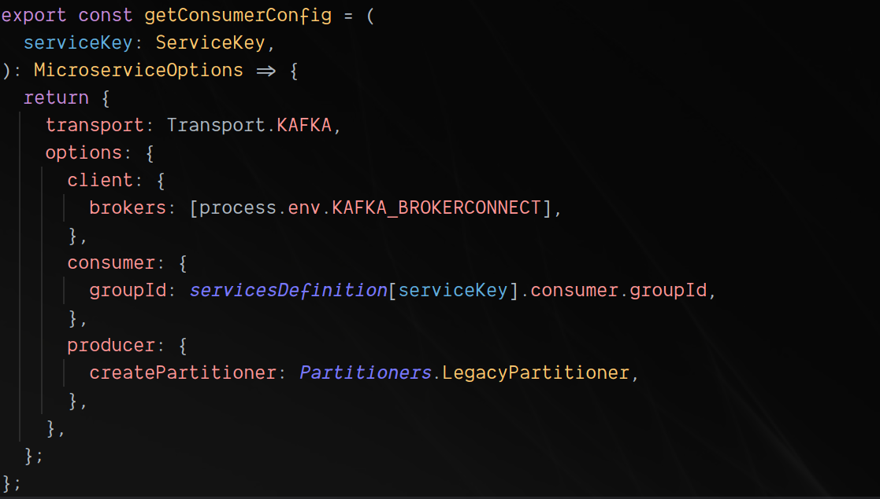
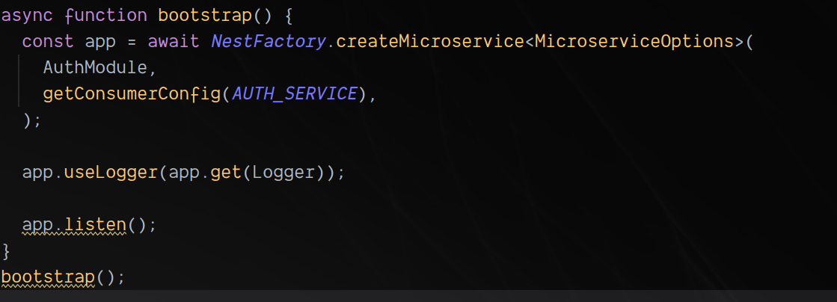
Microservices configuration Kafka
services.const.ts
service-keys.const.ts
clients-definition.const(type).ts
consumers-definition.const(type).ts
services-definition.const(type).ts
get-client-config.ts
get-consumer-config.ts

Slide 22
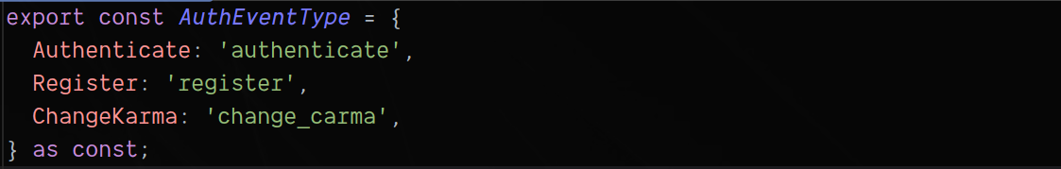
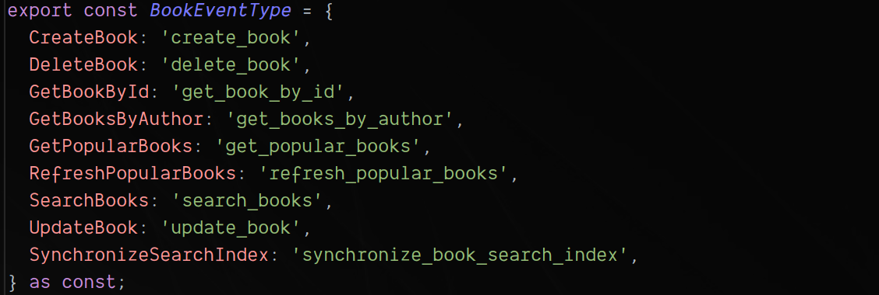
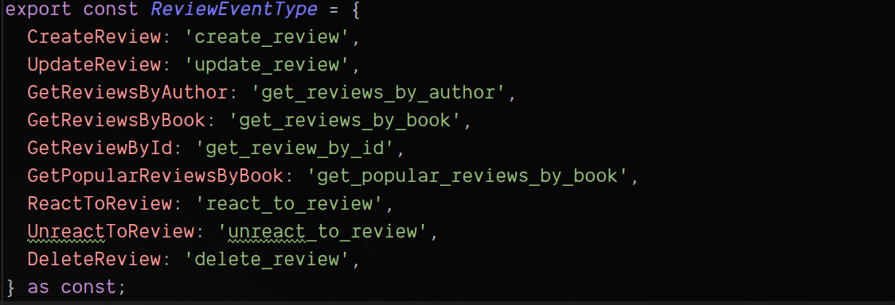
Microservices configuration Events
constants/*-event-type.const.ts
events/*.event.ts
types/*-event.type.ts
types/*-event-response.type.ts
types/*-event-handler-controller.type.ts
types/event-handler-controller.type.ts

Slide 23
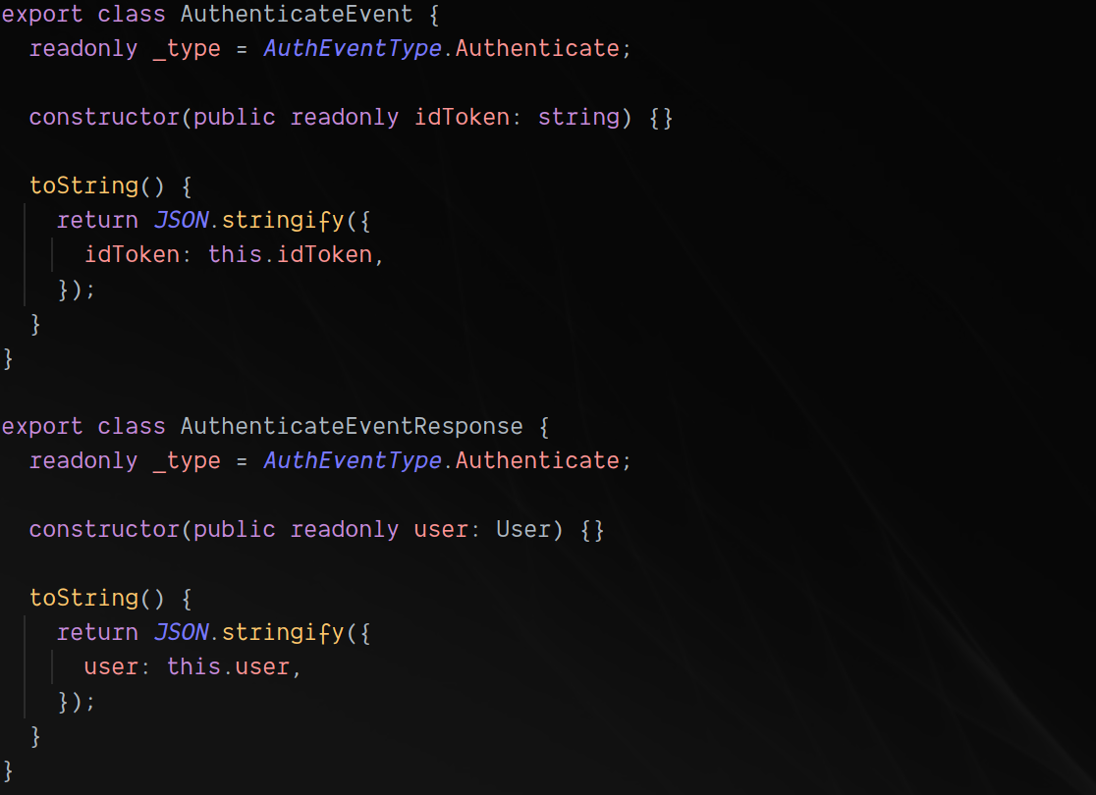
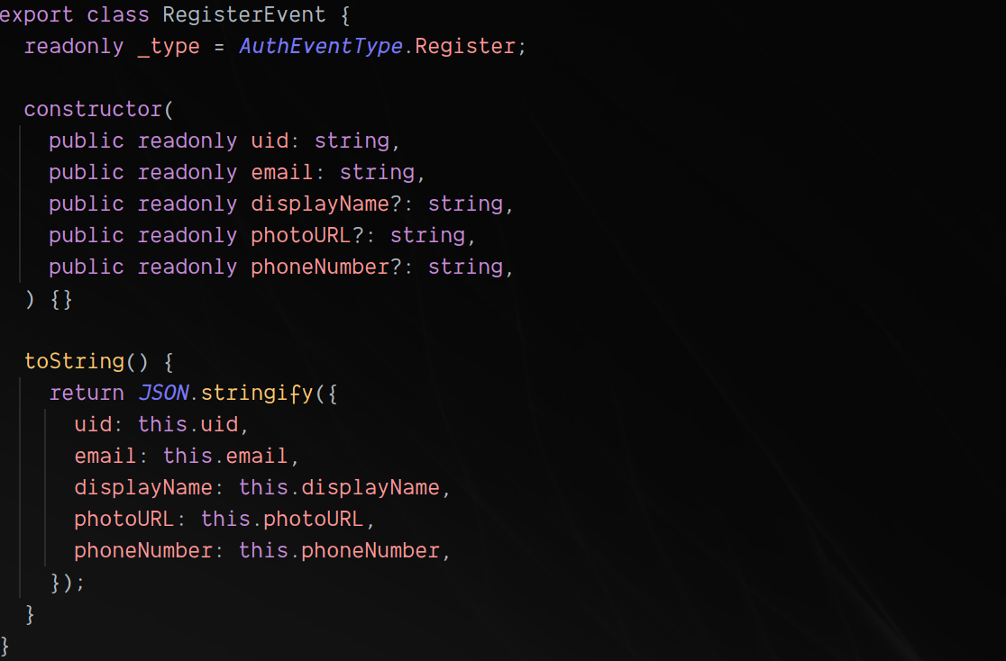
Microservices configuration Event schemas
constants/*-event-type.const.ts
events/*.event.ts
types/*-event.type.ts
types/*-event-response.type.ts
types/*-event-handler-controller.type.ts
types/event-handler-controller.type.ts

Slide 24
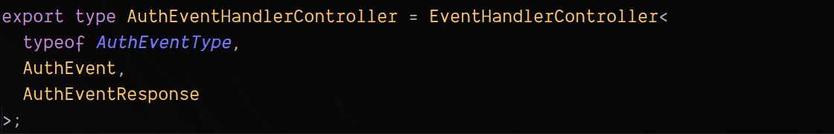
Microservices configuration Event types
constants/*-event-type.const.ts
events/*.event.ts
types/*-event.type.ts
types/*-event-response.type.ts
types/*-event-handler-controller.type.ts
types/event-handler-controller.type.ts

Slide 25
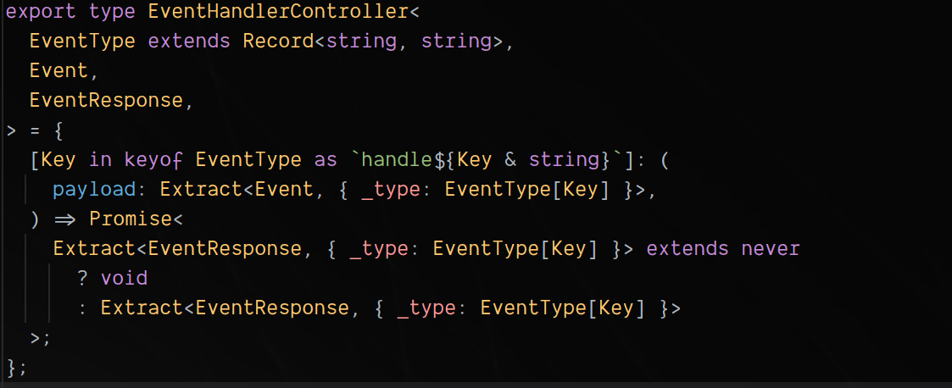
Microservices configuration Event handler
constants/*-event-type.const.ts
events/*.event.ts
types/*-event.type.ts
types/*-event-response.type.ts
types/*-event-handler-controller.type.ts
types/event-handler-controller.type.ts

Slide 26
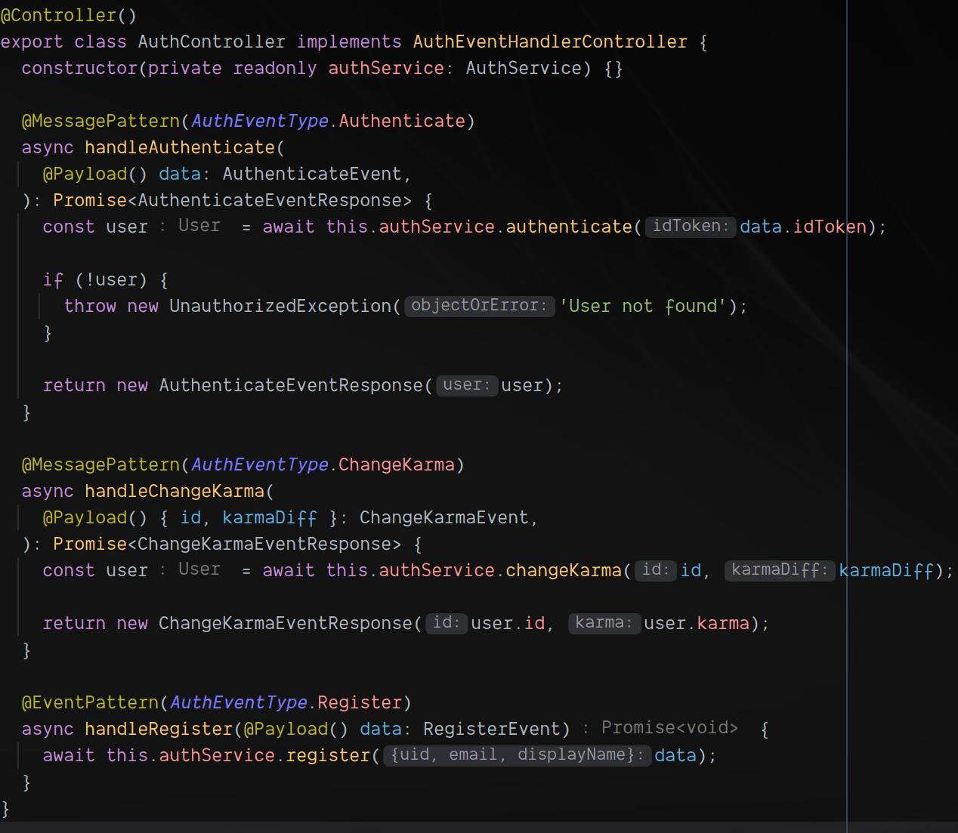
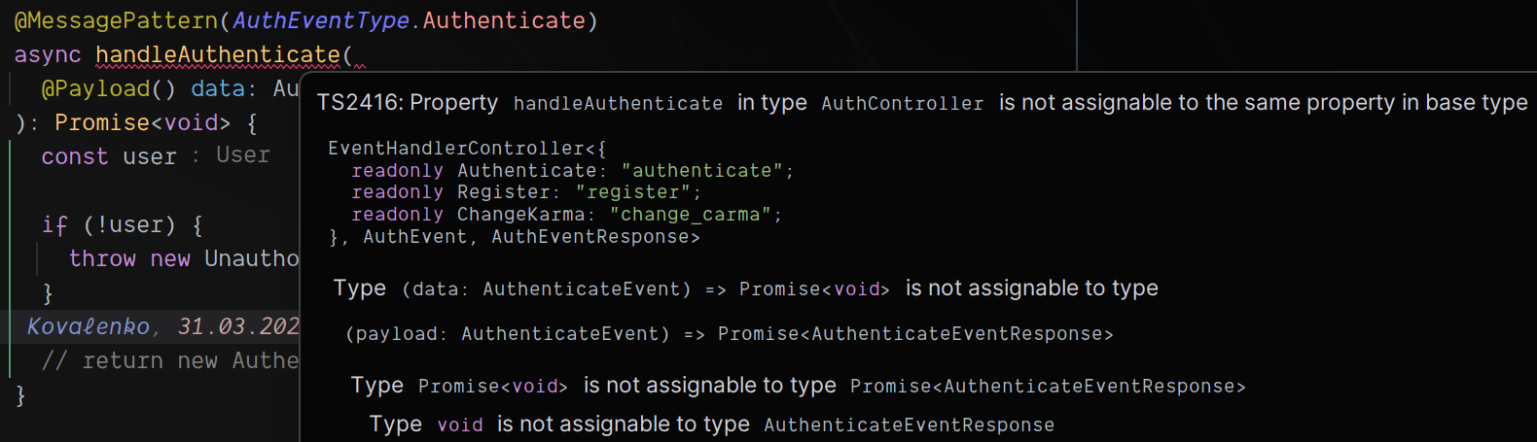
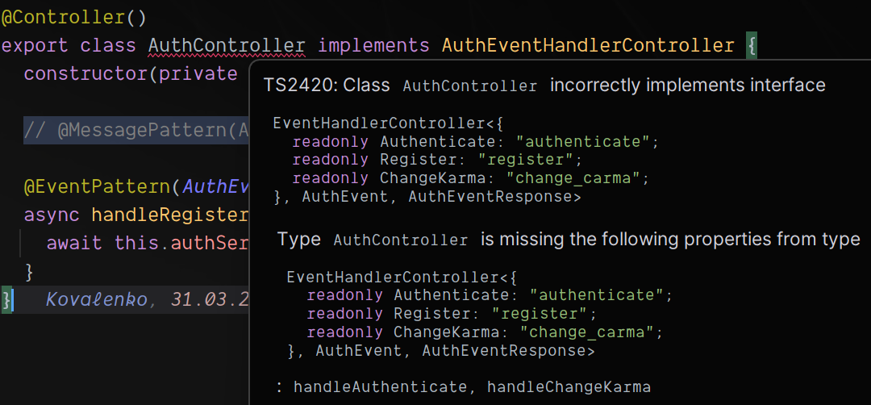
Microservices configuration Implement event handler

Slide 27
2. Database Setup with PostgreSQL
Design tables: User, Book, and Review.
Seed database with books.
Initialize a PostgreSQL instance on GCP or locally.

Slide 28
Database structure

Slide 29
Entity-Relationship Diagram

Slide 30
Reusable repositories library

Slide 31
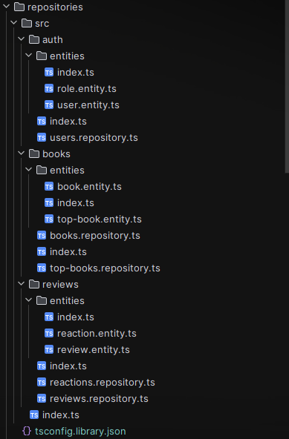
Structure
Tightly coupled entities in own namespace
Entities define schema
Repositories provide DAL

Slide 32
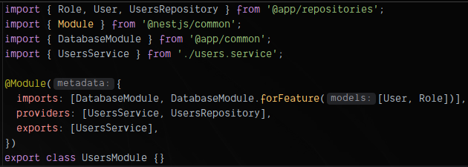
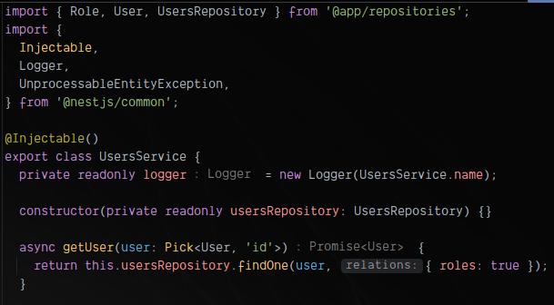
Usage
Import database module, used models
Provide needed repositories
Use it

Slide 33
Database Module

Slide 34
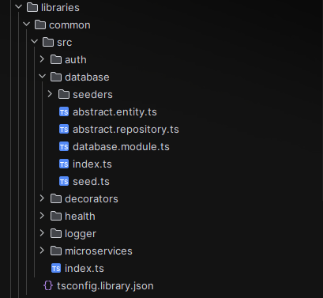
Database module structure
Entity and repository bases for code reuse
Module itself (DB connection logic)
Seeding logic

Slide 35
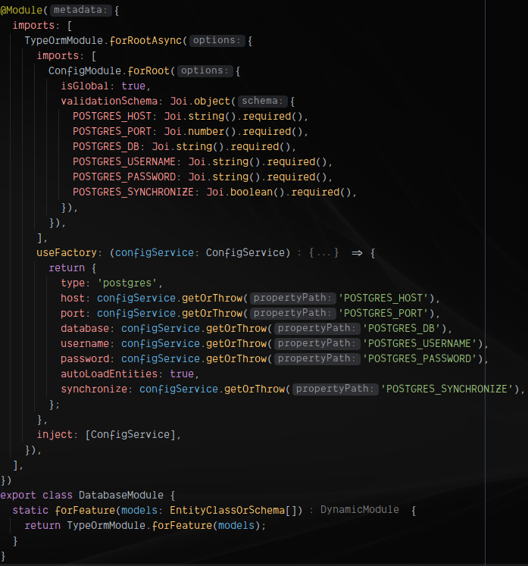
Database module definition

Slide 36
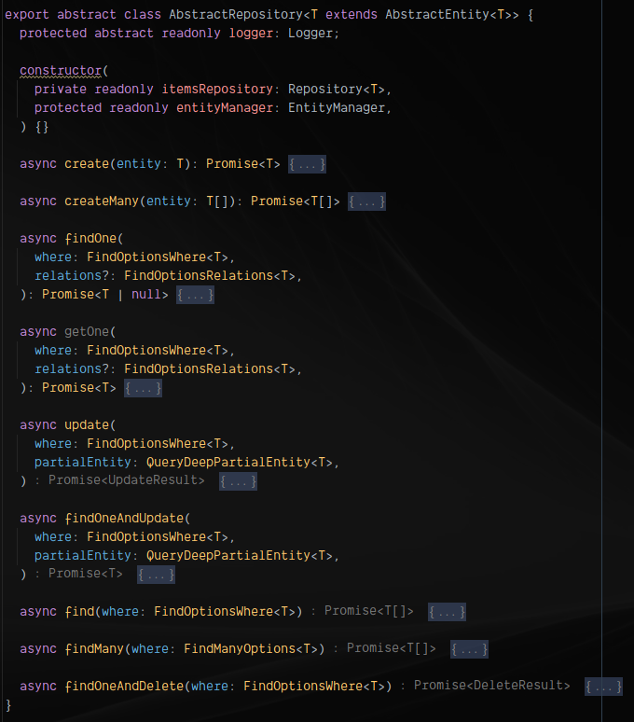
Abstract repository
Extending base typeorm repositories DAL
Exposing only needed logic
Code reuse
Fully decoupling DAL from BL
ORM agnostic approach

Slide 37
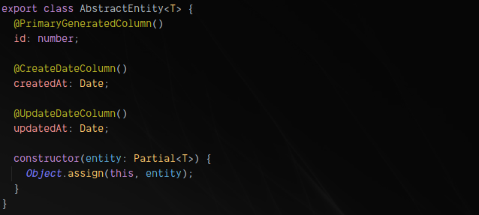
Abstract entity
Code reuse

Slide 38
Seeding

Slide 39
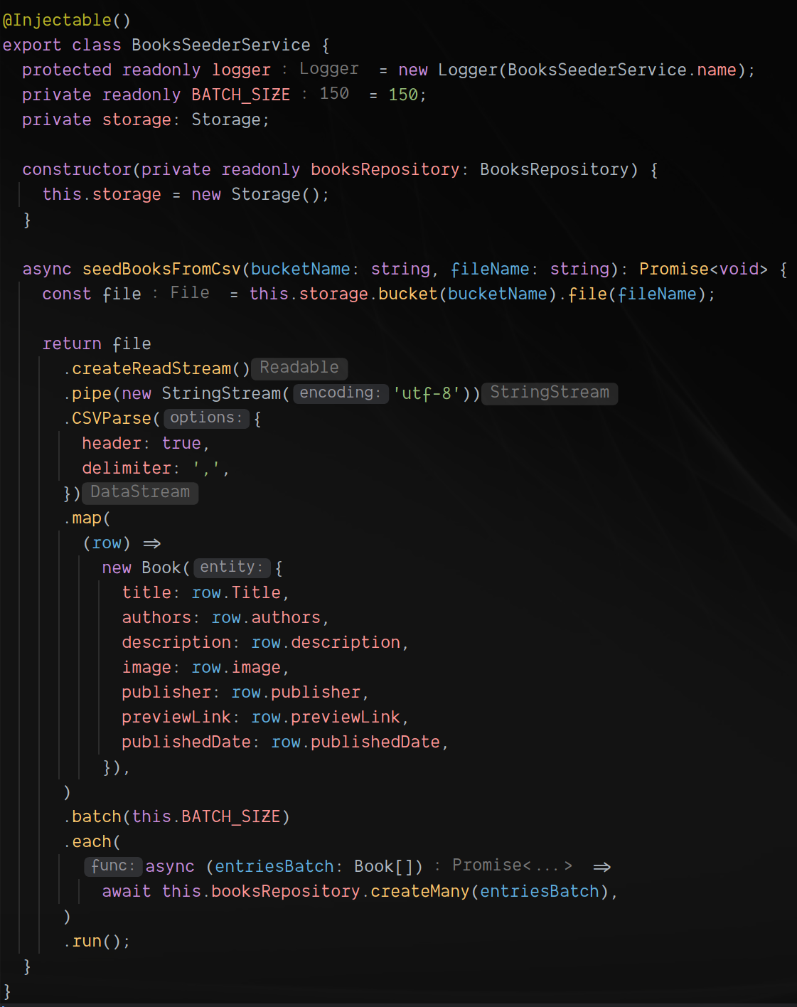
Books seeder (seeding from dataset)
Streaming data from file
Using scramjet for batching and backpressure handling
Using Cloud Store as data store
Converting from csv on the fly
Using official Amazon books dataset
(212404 unique books)
Multi-threading with scramjet

Slide 40
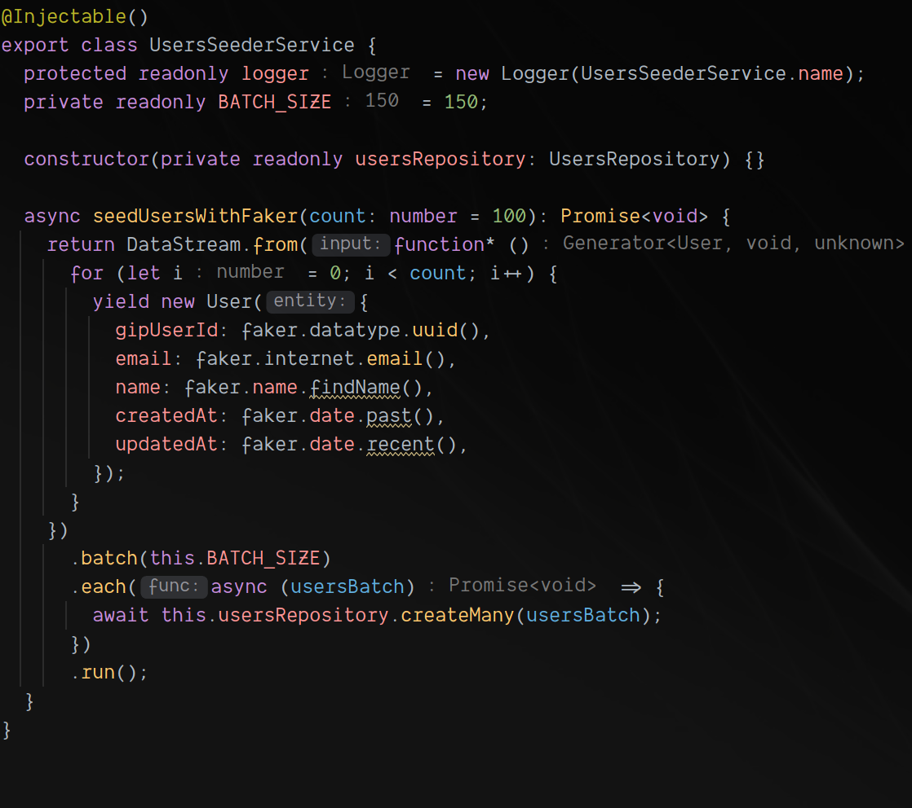
Users seeder (fake data)
Utilizing faker to generate fake users
Utilizing scramjet for generating custom stream and batching

Slide 41
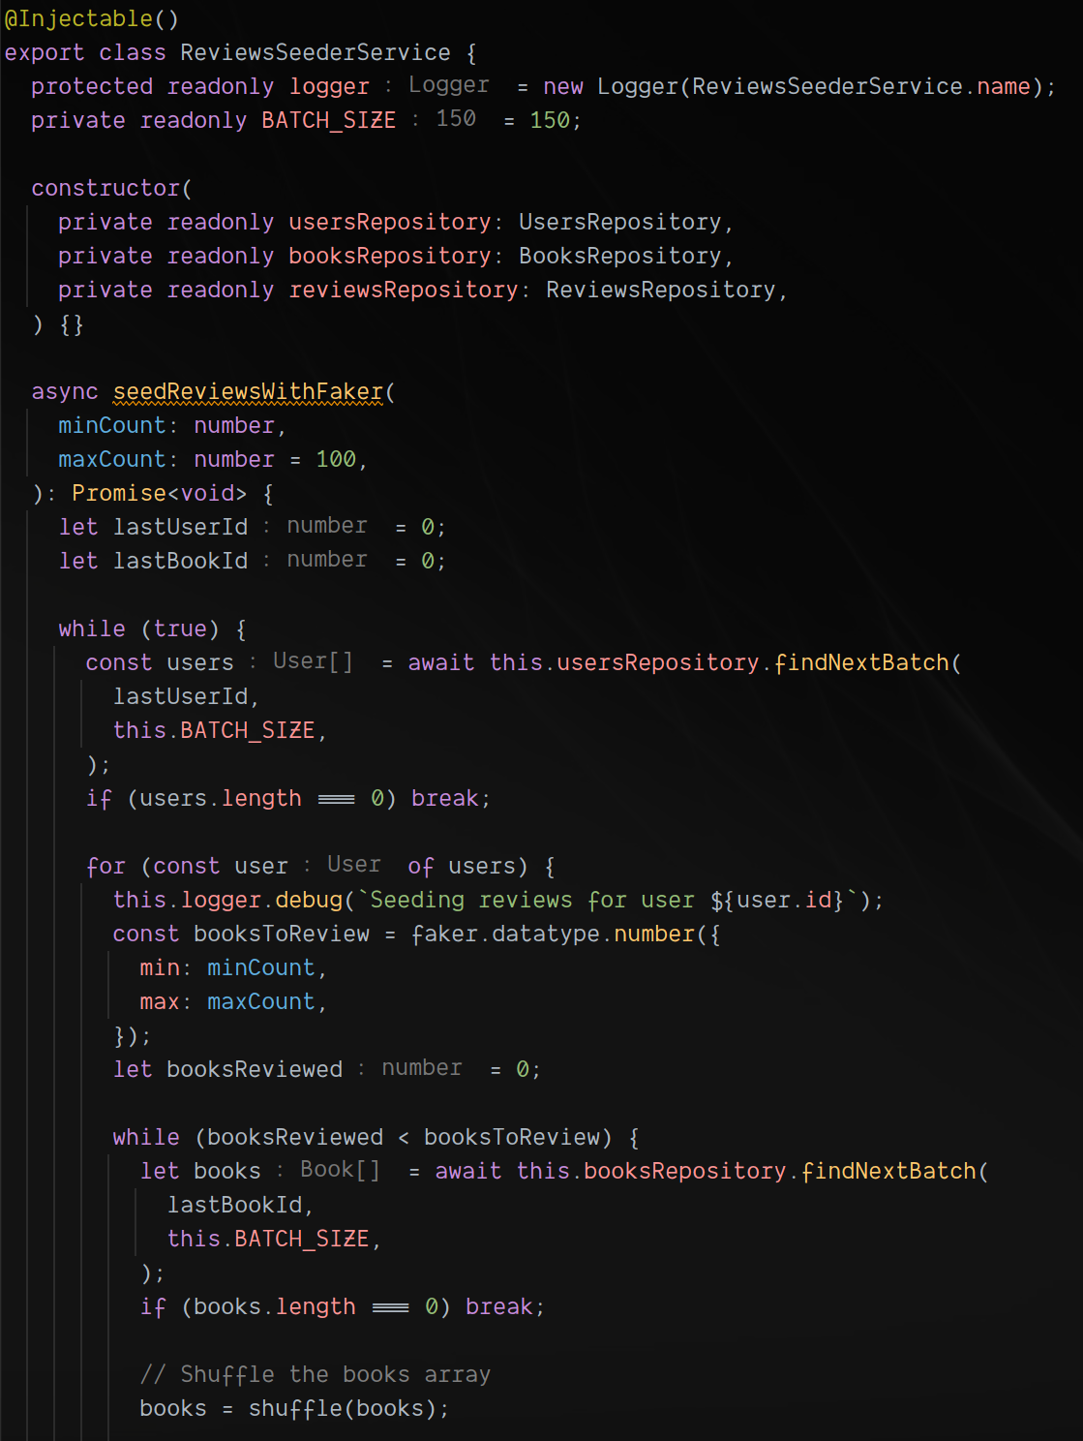
Reviews seeder (context-aware fake data)
Utilizing faker to load fake book reviews and randomizing review counts per book and user
Number IDs pros & cons
Using consecutive IDs for batching

Slide 42
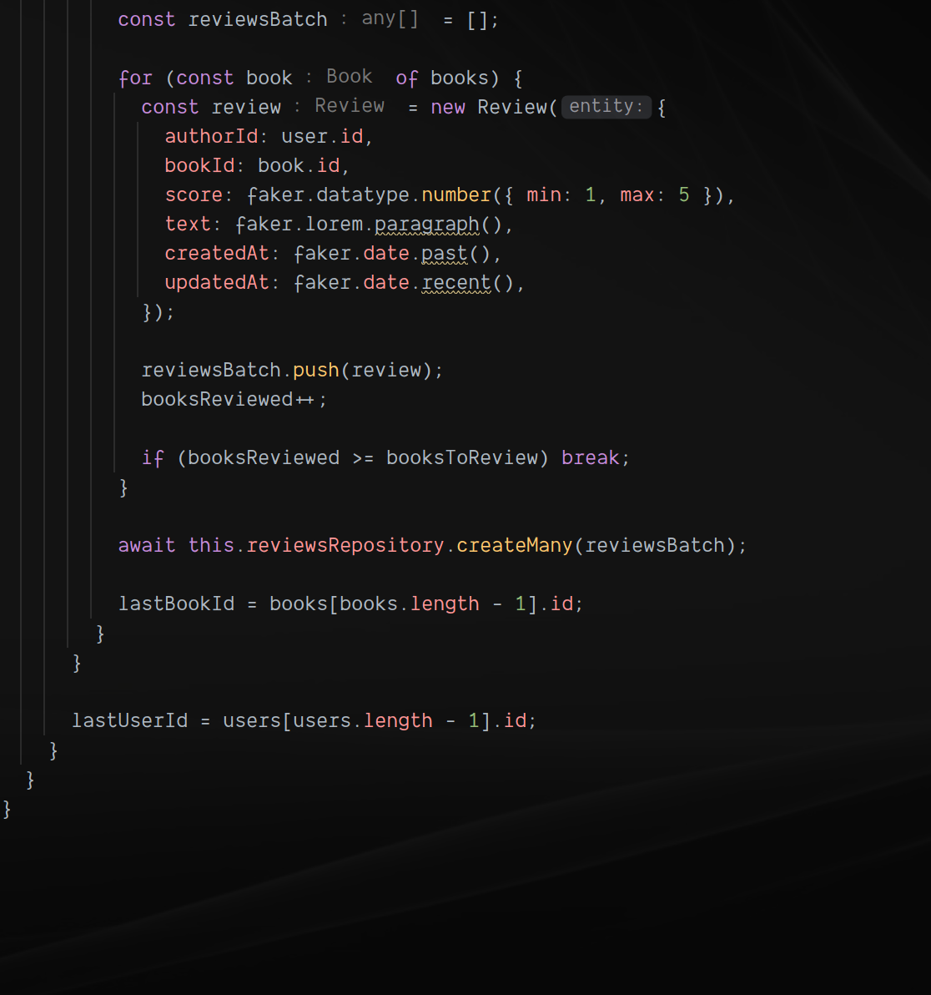
Reviews seeder (context-aware fake data)
Utilizing faker to load fake book reviews and randomizing review counts per book and user
Number IDs pros & cons
Using consecutive IDs for batching

Slide 43
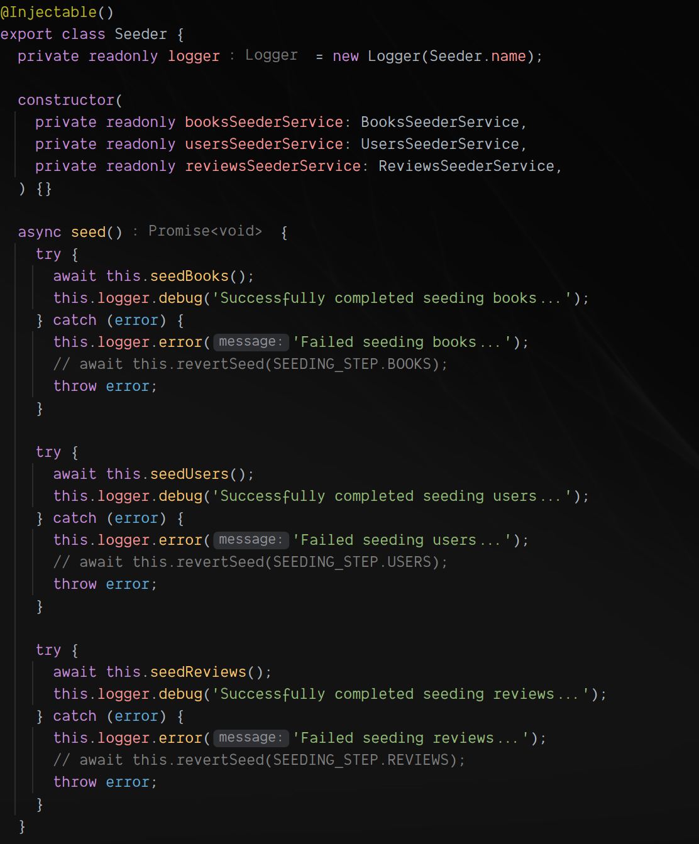
Seeder
Simple seeding orchestration
Coordinating domain with implementation (for example seeding from file, using faker, or other)

Slide 44
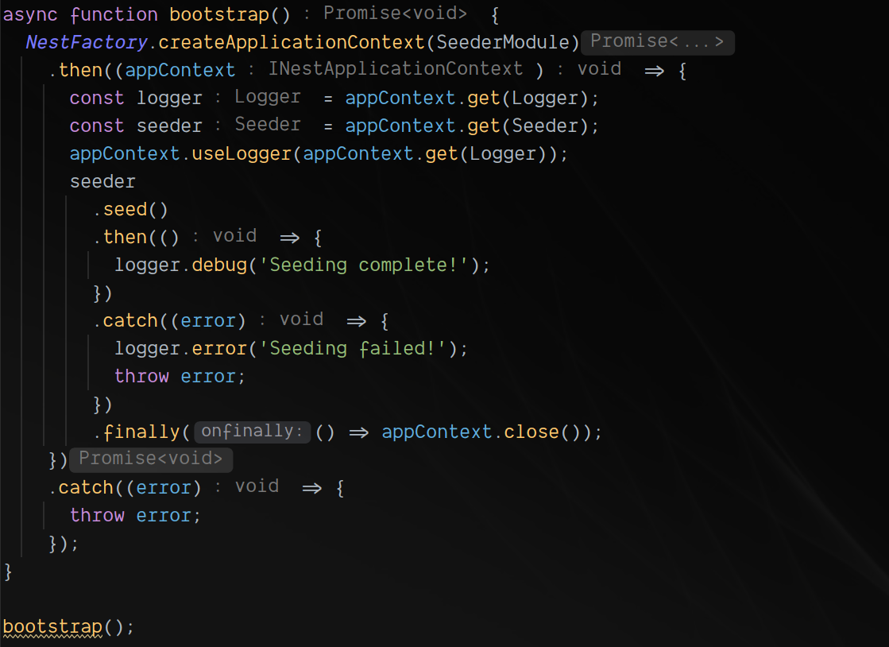
Seeding entrypoint
Import as module and seed from admin panel
Seeding as part of migration
Seed from npm script

Slide 45
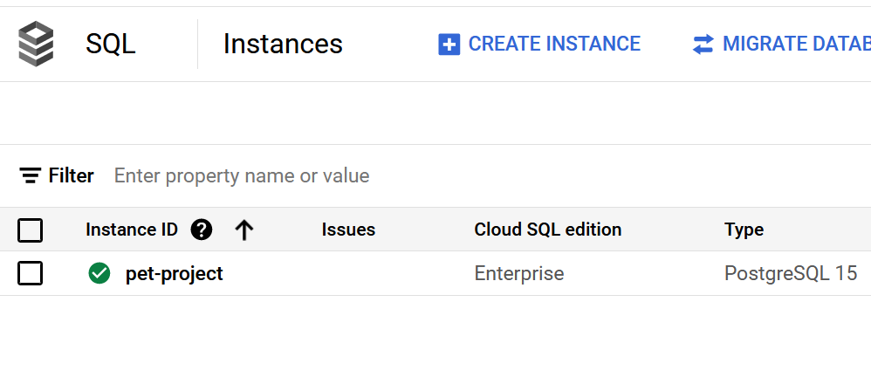
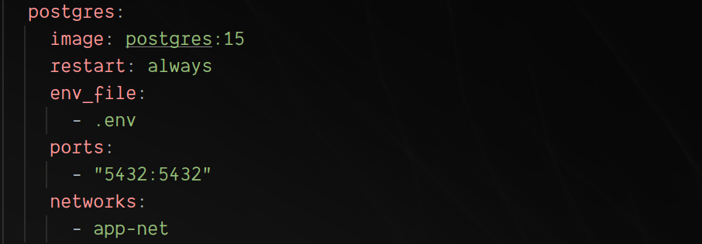
Database deployment
Local environment
Cloud environment

Slide 46
3. Deployment and Maintenance of Distribution System
Containerize each service using Docker.
Deploy the containers on GCP using Kubernetes.
Set up basic monitoring tools available on GCP for container health checks and error tracking.

Slide 47
Containerizing services

Slide 48
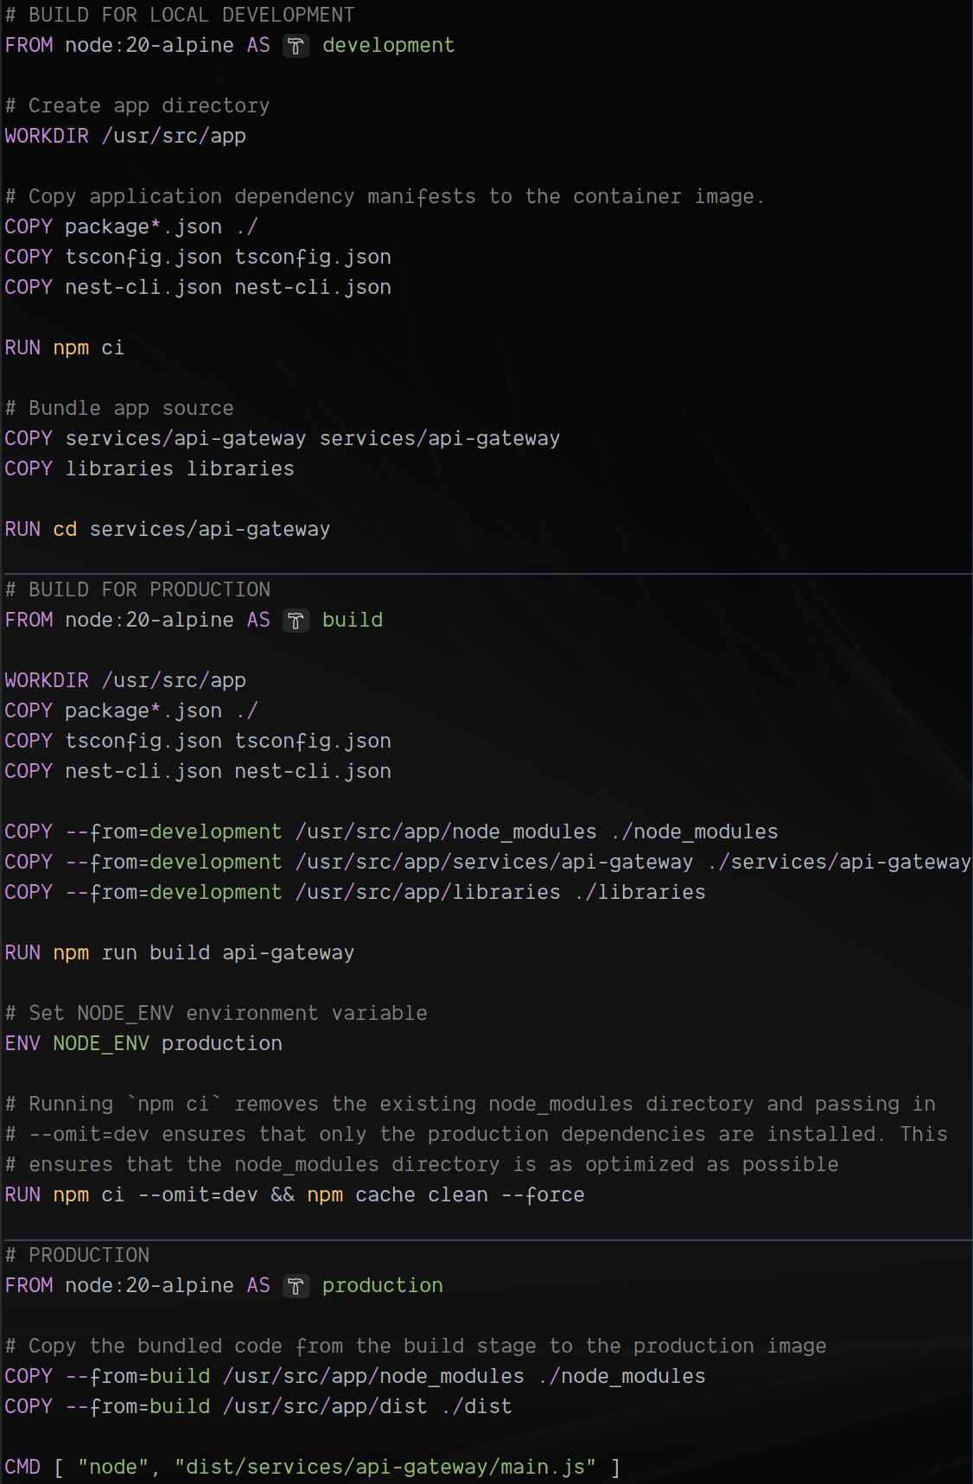
DOCKERFILE Api Gateway

Slide 49
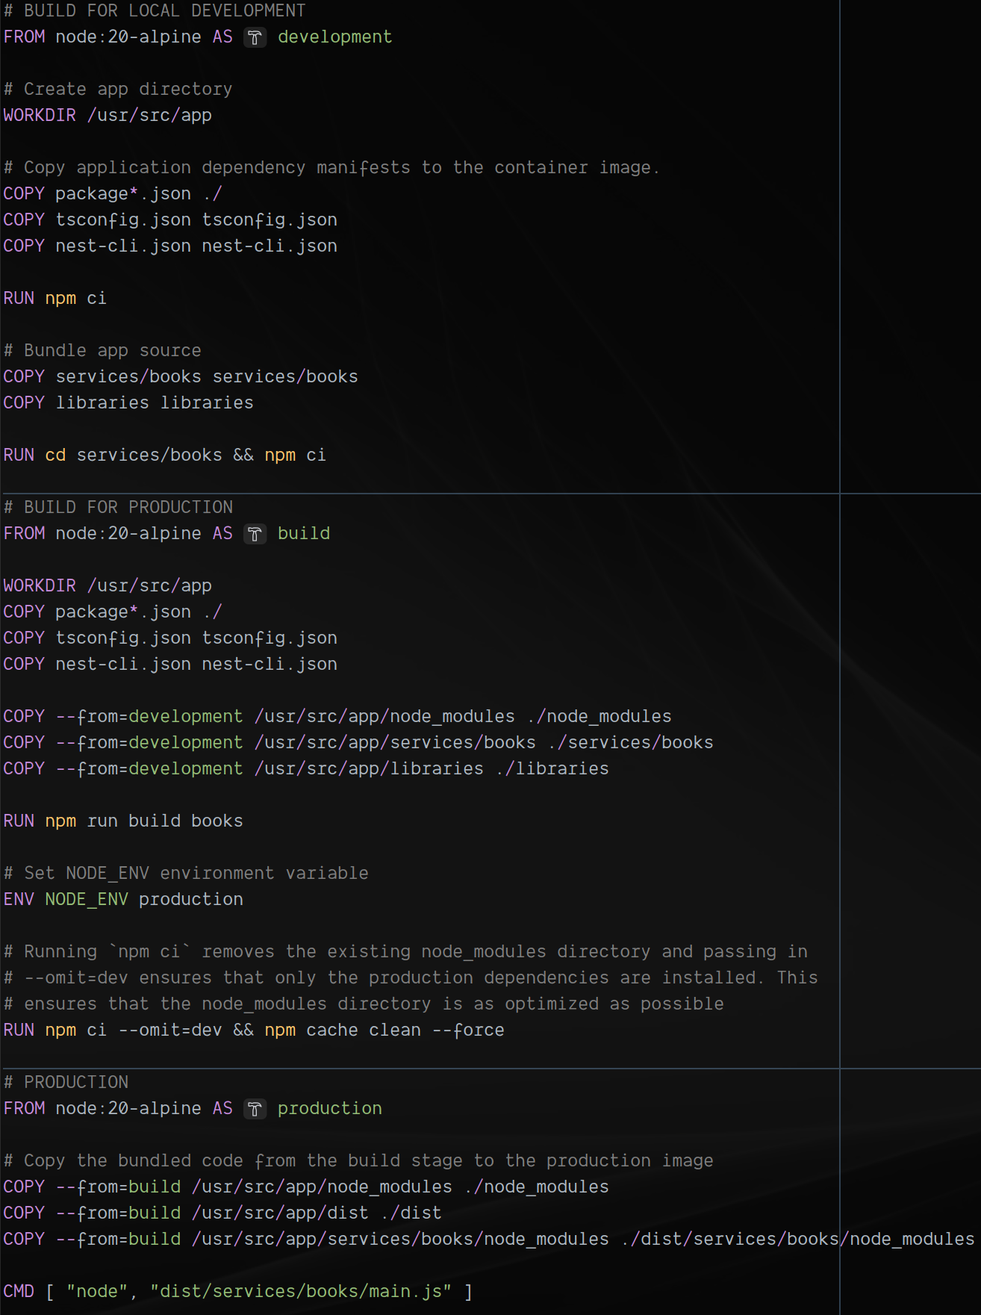
DOCKERFILE Service

Slide 50
Utilizing docker-compose for local development

Slide 51
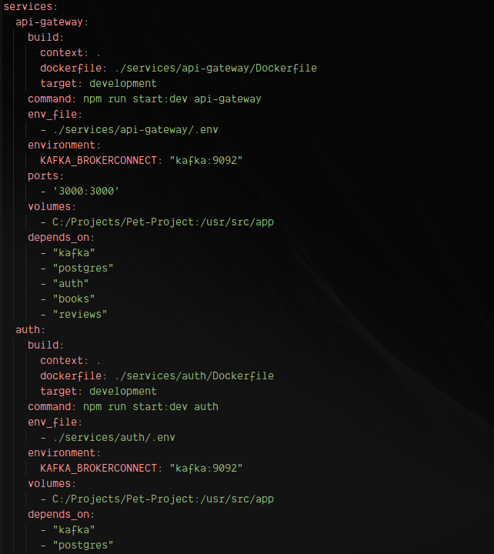
docker-compose

Slide 52

docker-compose

Slide 53

docker-compose

Slide 54

docker-compose
Zookeper included in obsidiandynamics/kafka image
Utilizing kafdrop for topic debug

Slide 55


Quorum controller: Zookeeper alternative
Uses an event-driven architecture with the KRaft protocol
Max partitions from 200k to 2 mil
x5 shutdown and x13 recovery speed on max scale
Committed metadata stored in memory (no need to load state from ZooKeeper)
Currently in early access and considered experimental

Slide 56

Kafdrop
View messages
Search messages
Viewing topic consumers
Viewing offsets
Checking topics

Slide 57

docker-compose
Elasticsearch
Tried cloud service – owerhelmingly expensive
Multiple nodes:
+ Redundancy
+ Increased query capacity
- Harder configuration
Overkill and expensive

Slide 58

docker-compose
Kibana for index analysis
Tired full elastic stack – too much resources needed

Slide 59
Kubernates configuration

Slide 60

Folder structure
Utilizing helm for k8s configuration as a code

Slide 61

Deployment config
Defining deployment
Using image from Artifact Registry
Defining resources, environments, binding port

Slide 62

Service config
Defining service
Binding port

Slide 63

Ingress config
Defining ingress
Binding service
Binding port

Slide 64

Secrets config
Not using Helm values.yaml to store environments and especially secrets, as them should not be committed to repository

Slide 65


Creating k8s cluster
Autopilot mode (recommended by GCP): GKE manages the underlying infrastructure such as node configuration, autoscaling, auto-upgrades, baseline security configurations, and baseline networking configuration. Pay per pod.
Standard mode: You manage the underlying infrastructure, including configuring the individual nodes. Pay per node.

Slide 66
Setting app cluster
Connect to cluster:
>gcloud container clusters get-credentials autopilot-cluster --region us-central1 --project pet-project
Apply secrets:
>kubectl apply -f ./postgres-secrets.yaml
Apply Helm config:
>helm install book-reviews-api .
If config changed:
>helm upgrade –install book-reviews-api .
Artifact Registry should have built images before start

Slide 67
Deployment Automation

Slide 68


Pipeline setup
Create individual repositories for each of services in Artifact Registry
Setup trigger in Cloud Build on push to GitHub repository
Push some code
Connect to k8s cluster and restart affected deployment (or automate this step with cloudbuild command from kubectl container)
Goto 3

Slide 69

cloudbuild.yaml
gcr.io/cloud-builders/docker – prebuilt container that allows build tag and push docker images directly in Google Cloud Build
Use kafdrop container to automatically restart deployment

Slide 70

cloudbuild.yaml
gcr.io/cloud-builders/docker – prebuilt container that allows build tag and push docker images directly in Google Cloud Build
Use kafdrop container to automatically restart deployment

Slide 71

cloudbuild.yaml
gcr.io/cloud-builders/docker – prebuilt container that allows build tag and push docker images directly in Google Cloud Build
Use kafdrop container to automatically restart deployment

Slide 72
Monitoring

Slide 73


Logs
Combining several log streams to see whole system logs at once

Slide 74

Tracing
Setup tracing to connect logs with traces and monitor latencies

Slide 75


Error reporting
Built-in functionality
Easy to configure automatic configurations

Slide 76





Configure uptime check
Setup reusable healthcheck endpoint
Create uptime check
Monitor availability across the globe
Configure notification channel to receive alerts

Slide 77


Utilizing built-in cluster monitoring
Overall cluster status
Cluster workloads status (per deployment)

Slide 78

Cost optimization
See CPU and Memory utilization to optimize requested pod resources

Slide 79
4. Book Service with Elasticsearch and PostgreSQL-based Cache
Integrate Elasticsearch for full-text search capabilities on books.
Implement PostgreSQL-based cache using materialized views for top searched or top-reviewed books.

Slide 80

Book Service Functionality
Books Crud
Searching books with elasticsearch
Retrieving top books utilizing cache
Managing search index

Slide 81
Full-Text search

Slide 82
Why not just use PostgreSQL?
Elasticsearch
PostgreSQL (tsvector)
Scalability:
Engineered for distributed and scalable search, handling large datasets with ease.
Performance:
Optimized for high-speed search queries and real-time indexing, delivering rapid results.
Advanced Capabilities:
Provides sophisticated querying, analytics, and custom scoring options.
Use Case:
Ideal for applications requiring robust search capabilities and high-speed data retrieval.
Integration:
Natively integrated within PostgreSQL, streamlining the setup process and minimizing additional infrastructure requirements.
Simplicity:
Offers straightforward configuration and maintenance within a relational database framework.
Efficiency:
Performs well with smaller datasets and simpler search needs.
Use Case:
Well-suited for applications with moderate search requirements, particularly where relational data management is essential.

Slide 83
Fuzzy search

Slide 84


Utilizing pg_trgm
Utilize GiST index to speed up results
Utilizing trigram distance operator <->
Sorting by lowest trigram distance
For something more complicated like calculating hit scores, relevance weight/boost, and faster response time on larger dataset there is no way without Elastic instead

Slide 85
Elasticsearch

Slide 86


Connecting Elasticsearch
Utilizing @nextjs/elasticsearch
Creating separate module for search

Slide 87

SearchBooksService
Check index existence
Create index
Clear index
Get index books count
Add book to index
Remove book from index
Update indexed book
Search book in index

Slide 88

SearchBooksService
Check index existence
Create index
Clear index
Get index books count
Add book to index
Remove book from index
Update indexed book
Search book in index

Slide 89

SearchBooksService
Check index existence
Create index
Clear index
Get index books count
Add book to index
Remove book from index
Update indexed book
Search book in index

Slide 90

SearchBooksService
Check index existence
Create index
Clear index
Get index books count
Add book to index
Remove book from index
Update indexed book
Search book in index

Slide 91


Using SearchBooksService
Index book on creation
Remove book from index on delete
Update index on book update
Search book
Synchronize whole search index

Slide 92

Using SearchBooksService
Index book on creation
Remove book from index on delete
Update index on book update
Search book
Synchronize whole search index

Slide 93

Using SearchBooksService
Index book on creation
Remove book from index on delete
Update index on book update
Search book
Synchronize whole search index

Slide 94

Using SearchBooksService
Index book on creation
Remove book from index on delete
Update index on book update
Search book
Synchronize whole search index

Slide 95
PostgreSQL-based cache

Slide 96
What Postgres handles itself
Three Types of Caching:
PostgreSQL uses shared_buffers setting in postgresql.conf to define the memory allocated for caching.
Uses an 8KB page size for organizing data.
Execution is faster if same query is re-executed, as all the blocks are still in cache of PostgreSQL server at this stage
Query Result Caching: Stores the exact output of SELECT queries, reducing disk access and CPU usage for repeated queries.
Query Plan Caching: Saves the results of the optimizer, allowing prepared statements to reuse execution plans, saving computation time.
Relation Caching: Involves storing entire tables or indexes in memory to speed up access times.

Slide 97
Materialized view

Slide 98
What is the difference
Materialized View
View
Database object that contains the results of a query.
Data is stored physically on disk.
Requires explicit refreshing to update data, as it doesn't reflect changes in underlying tables automatically
Virtual table that dynamically generates results based on a query whenever it is accessed
Data is not stored; the query is executed each time the view is accessed
Simplifying complex query logic

Slide 99

Top books Entity
Materialized View through TypeOrm
Utilizing ViewEntity Decorator
Defining query
Treat like a regular Entity
Refreshing through separate query

Slide 100

Top Books Repository
Materialized View through TypeOrm
Utilizing ViewEntity Decorator
Defining query
Treat like a regular Entity
Refreshing through separate query

Slide 101

Top Books service
Using Cron to refresh cache regularly
Ways to trigger refresh:
Separate service with one instance
Cloud function
Locking mechanism

Slide 102
Lock Module

Slide 103

Locks Module
Connect Redis for storing locks
Located at libraries folder to be included anywhere in distributed system

Slide 104

Locks Service
EX – expire
NX - ensures that the key will only be set if it does not already exist
Lock key – unique identifier of a lock
Release lock if we want to give a try to another instance, or used permanent lock

Slide 105
5. Review Service with Kafka and Distributed Transactions
Users can submit reviews for books
Implement distributed transactions: when a user submits a review, an event is sent to Kafka, which then…
Kafka setup: install a Kafka cluster, define topics for reviews, and integrate with NestJS.

Slide 106

Review Service Functionality
Review crud
Retrieve reviews by book based on reactions
Upvote or downvote particular review

Slide 107
Idea with transaction
We place review and not show it yet
Review passes sentiment check (moderation)
We marking review as confirmed and it appears
Increasing user karma

Slide 108
How to handle transactions in distributed systems?

Slide 109
Monolith
Concept:
A modular monolith is a system designed modularly but deployed as a single unit.
Prioritizes strong write consistency over independent deployment and scaling of microservices.
Modules encapsulate data access and use in-memory method calls for operations.
Drawbacks:
Limits independent deployment and scaling of modules.
Logical table separation can degrade into a shared integration layer over time.
Increased coupling and coordination during development.
Consistency: High, with local transactions.
Scalability: Low, due to shared runtime and database.
Deployment: Single deployment unit, difficult to scale independently.
Coupling: High, modules are tightly coupled.
Use Cases: Systems prioritizing strong write consistency over independent scaling.

Slide 110


Monolith

Slide 111
Two-Phase Commit
Concept:
Uses a distributed transaction manager to ensure atomic updates across multiple data sources.
Commonly implemented in systems requiring strong data consistency with diverse data sources.
Drawbacks:
Scalability constraints and potential recovery failures.
Storage and singleton requirements in dynamic environments.
Consistency: High, with distributed transaction management.
Scalability: Medium, limited by the transaction manager's constraints.
Deployment: Requires reliable storage and highly available transaction manager.
Coupling: Medium, centralized coordinator for transactions.
Use Cases: Systems needing strong consistency across heterogeneous data sources.
Notes:
The XA specification describes what a resource manager must do to support transactional access.

Slide 112

Two-Phase Commit
Notes:
The XA specification describes what a resource manager must do to support transactional access.

Slide 113
Orchestration
Concept:
A centralized service coordinates state changes across distributed services.
Ensures overall consistency by retrying operations or taking corrective actions.
Drawbacks:
Complex distributed programming model.
Requires idempotency and compensating operations from services.
Eventual consistency and possible unrecoverable failures during compensations.
Consistency: Eventual, managed by a central orchestrator.
Scalability: Medium, with coordination overhead.
Deployment: Centralized coordinator with state tracking.
Coupling: Medium, central orchestrator with distributed services.
Use Cases: Systems requiring coordinated state changes across diverse services.

Slide 114

Orchestration

Slide 115
Choreography
Concept:
Decentralized event-driven approach where services react to events and trigger subsequent actions.
No centralized control, each service participates in the workflow decision-making process.
Drawbacks:
Scattered global system state and coordination logic.
Eventual consistency with potential challenges in querying multiple data sources for state discovery.
Consistency: Eventual, with decentralized event handling.
Scalability: High, with decoupled services.
Deployment: Decentralized, services communicate via events.
Coupling: Low, independent service interactions.
Use Cases: Systems with loosely coupled services needing high scalability and resilience.

Slide 116

Choreography

Slide 117
Parallel Pipelines
Concept:
Independent and parallel processing of requests by multiple services.
Suitable for situations without temporal binding between services.
Drawbacks:
Requires temporal dismantling and difficulty in reasoning about the global system state.
Consistency: Variable, depends on individual service processing.
Scalability: High, independent parallel processing.
Deployment: Simple, with independent service processing.
Coupling: Low, services process requests independently.
Use Cases: Systems with independent processing steps and no temporal binding.

Slide 118

Parallel Pipelines

Slide 119

How to choose a distributed transactions strategy
Notes:
The XA specification describes what a resource manager must do to support transactional access.
Happy paths - Strong data consistency for the happy scenarios.

Slide 120
My choice: Orchestration-based saga pattern
Reasons:
Database-per-microservice approach in mind
We can scale out our data stores independently
If one data store fail, that failure will be isolated from other services.
The Saga pattern uses a sequence of local transactions (transactions within a service). Each of these local transactions will update that service data store, and then sends a message or event to trigger the next local transaction in the saga.
If a local transaction should fail, the service within a saga will perform compensating transactions that undo changes that were made in the previous service.

Slide 121


Example: Orchestration-based saga pattern

Slide 122

Saga flow

Slide 123



Implementation Folder structure
Storing saga in API service
Utilizing libraries to reuse step for consistency

Slide 124

Implementation Steps
PlaceReviewStep
CheckReviewStep
ConfirmReviewStep
IncreaseKarmaStep

Slide 125

Implementation Steps
PlaceReviewStep
CheckReviewStep
ConfirmReviewStep
IncreaseKarmaStep

Slide 126
Implementation Steps
PlaceReviewStep
CheckReviewStep
ConfirmReviewStep
IncreaseKarmaStep

Slide 127

Implementation Steps
PlaceReviewStep
CheckReviewStep
ConfirmReviewStep
IncreaseKarmaStep

Slide 128

Implementation Steps
PlaceReviewStep
CheckReviewStep
ConfirmReviewStep
IncreaseKarmaStep

Slide 129

Implementation CreateReviewSaga
Storing state in memory

Slide 130

Using CreateReviewSaga

Slide 131
6. User Service with GCP Identity Platform
Integrate GCP Identity Platform for user registration and authentication.
Endpoints: register, login, and get profile.

Slide 132

User Service Functionality
Creates user on registration
Returning user on authenticate request
Checking idToken with IP on authenticate request
Handles user karma changes

Slide 133




Reusable auth components
Auth guard for authentication handling in Exposed services
Roles decorator for adding role to metadata to further check in Auth Guard
Current user decorator to provide user from context after verification

Slide 134

Reusable auth guard
Sending message to Auth Service with idToken, expected to receive User Profile in response.
Convenient but wasteful
Also checks role if decorator provided

Slide 135
GCP Identity platform

Slide 136


Sending Webhook (Cloud Function)
Binding cloud function with IP
Using gcip-cloud-functions library to get user information
Storing custom API key as secret, backend url as variable.

Slide 137

Handling Webhook (Webhook Controller)
Handling incoming auth event
Using API KEY authentication method for verifying

Slide 138

Handling Webhook (Webhook Service)
Notifying Auth service about new registration

Slide 139

Frontend integration (Registration)
Utilizing firebase.js
Additional customization available via firebase
For 3-party login and register is the same thing: IP recognizes first login as registration, unlike a local

Slide 140

Frontend integration (Login)

Slide 141
7. Unit Testing
Write unit tests for each microservice focusing on service logic, controllers, and utilities.
Mock external calls, like database queries or external API requests.

Slide 142

Base testing idea

Slide 143

reviews.service.spec.ts
Notes:
Incomplete

Slide 144

reviews.service.spec.ts

Slide 145

reviews.service.spec.ts

Slide 146

reviews.service.spec.ts

Slide 147

reviews.controller.spec.ts

Slide 148

reviews.controller.spec.ts

Slide 149

reviews.controller.spec.ts

Slide 150
Feedback

